Slide 1

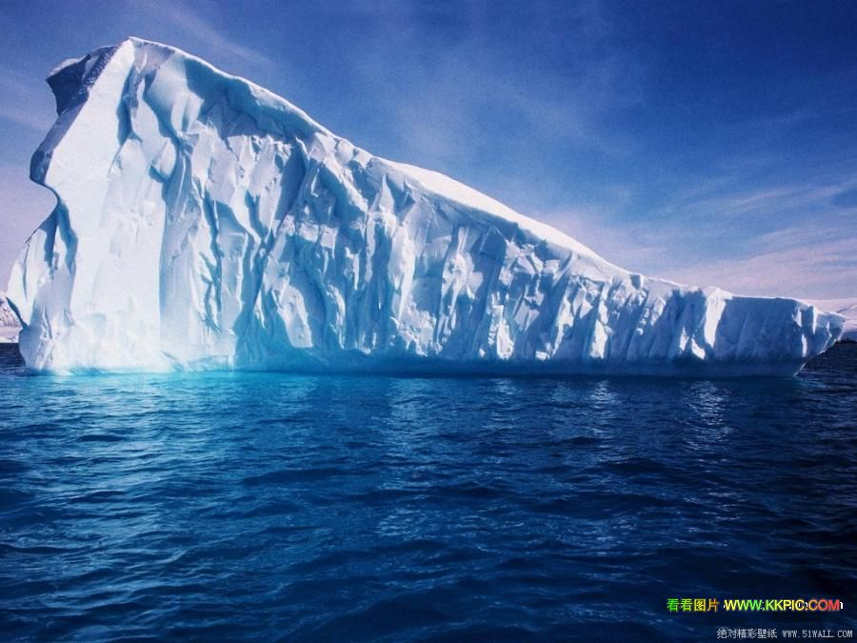
Module 1
Deep South

Slide 2
Language Points

Slide 3
1.With annual rainfall close to zero, Antarctic is technically a desert.
南极洲年降雨量几乎为零，严格来说该区域就是一片荒漠。
1).with annual rainfall close to zero 为介词短语，表示原因，由介词“介词＋名词＋形容词（词组）组成，也即“with +宾语＋形容词短语”构成的复合结构。例如：

Slide 4
With so many students weak in their pronunciation, they started from the beginning.
He sat there quietly with mouth half open, listening to the radio.
He sat there with his eyes ________(fix) on the sky.
fixed
He sat there with his hand ________ (point) at me.
pointing
He went to the classroom with a lot of homework _____.
to do

Slide 5
2). close to 几乎，近于，靠近
They sat there close to each other.
Their house was close to the church.
Close to a hundred experiments have been made so far.
到目前为止已进行了近百次的试验。

Slide 6
3）technically adv. 严格地；准确地按照法律、词义等的解释；技术上的
① Although technically speaking you may not have lied, but you certainly haven’t told us the whole truth.
尽管严格来说你没有撒谎，但肯定你没把实情都告诉我们。

Slide 7
② Technically, I’m not supposed to do this, but we’re shot-staffed.
严格来说，我不该这么做，可是我们缺少人手。
③Technically the building is a masterpiece, but few people like it.
就技术而言，那座建筑物是个杰作，但却没人喜欢。

Slide 8
2.Covering about 14 million square kilometers around the South Pole, it is the fifth largest continent in the world.
南极洲覆盖了南极圈周围1，400平方公里的面积，是世界第五大洲。
1)covering about…在句子中作状语。

Slide 9
2) the fifth largest continent in the world. 形容词最高级前面的修饰成分为序数词。
Is it the third longest river in the world?
形容词最高级前面还可有其他的成分。
It was by far the best university I have visited.
It was of the very highest quality.

Slide 10
3.On average it is two kilometers thick, but in some places it reaches a depth of five kilometers.
(南极洲)冰层平均厚度为2，000米，但某些地方厚度可以达到5，000米。

Slide 11
词组two kilometers thick，形容词thick 增加了修饰成分 two kilometers。例如：
The rope is two meters long.
The well is 12 meters deep.
但是注意下面情况：
It is a 12-meter-long rope.
The 12-meter-deep well is the deepest one in our village.

Slide 12
4.Yet Antarctica is full of wildlife, which has adapted to its extreme conditions.
但南极洲仍然栖息着许多野生生物，它们已经适应了那里的恶劣的条件。
1) full of 充满了 The room is full of smoke.

Slide 13
2)adapt ①使适应；使适合（与to连用）。
He could not adapted to his way of life to the company.
他的生活方式无法适应公司的要求。
②adapt (oneself) to …适应
他很快适应了新环境。
③ 改造、修改(为…所用)改写（与for 连用）

Slide 14
I adapted our old garage for use as a workshop.
我把我们的旧车库改为工作室用。
They’re trying to adapt this story for the film.
他们正在将这篇小说改编成电影。

Slide 15
5.As a result, it has become a window on the past, and can give researchers lots of useful information.
因此,它已经变成人们了解过去的窗口,可为研究者提供大量有用的信息。
window 窗户;窗口 在此引申为“获得信息的渠道” 。
International news broadcasts provide a window on the world.

Slide 16
6. But the long Antarctica winter night, which lasts for 182 days (the longest period of continuous darkness on the earth ) as well as the extreme cold and lack of rainfall, means that few types of plant can survive there.
但是南极洲冬天的夜晚长达182天(地球上持续时间最长的黑暗时期), 气候极度寒冷降雨量极少,这意味着很少有植物能够在这里生存。

Slide 17
1) which lasts for 182 days… 这是一个非限制性定语从句。限制性定语从句中，which 有时并不代表一个名词，而是代表前面句子的全部或部分意思：
He changed his mind, which made all of us angry.
The students finished the work by themselves, which was encouraging.

Slide 18
2) as well as 是一个并列连接词
He wrote three famous novels as well as some plays.
It is a political as well as an economic question.
3) few 表示很少，几乎没有。

Slide 19
7.Gases and minerals, in the form of volcanic dust trapped in the ice, can tell us a lot about what the world’s climate was like in past ages.
这些以火山灰形式封冻冰层里的气体和矿物质可以告诉我们很多关于远古时期全球气候的状况。
1)in the form of volcanic dust trapped in the ice 是一个介词短语作定语,修饰gases and minerals,可以把它改成非限制性定语从句:
which are in the form of volcanic dust trapped in the ice.

Slide 20
2)in the form of “以…形式” 或“呈……形状”
The man staircase was in the form of a big “S” .
主楼梯呈S形。
People are bombarded with information in the form of magazines and TV advertising.
信息以杂志和电视广告的形式向人们连续轰炸。
3)trapped in the ice 是-ed 形式作定语的情况，修饰volcanic dust。

Slide 21
8. Since most Antarctica rocks are dark in color, they stand out against the white background and are easy to identify and collect.
南极洲的大多数岩石是深色的，它们在白色冰雪的映衬下格外鲜艳，也就易于识别和搜集。

Slide 22
stand out
1)突出；显眼
① The hat stood out in the window because of its strange shape.
橱窗里的那顶帽子因造型奇特而引人注目。
② Words stand out well against /from a dark background.
由深色底衬托出的字很醒目。

Slide 23
2)卓越；杰出；远远地超过
They were all attractive, but she stood out from the others.
她们都很迷人，但她比其他人更有魅力。

Slide 24
9. Not until the late 18th century did the British explorer James Cook cross the Atlantic Circle, but he never saw land.
直到18世纪末，英国探险家詹姆斯 · 库克才穿越了南极圈，但他却从未发现陆地。
not until 用在句首应该用倒装结构。

Slide 25
until 用在肯定句中主句的谓语动词应该是延续性动词,用在否定句中用非延续性动词, 也可以用在强调句型中。
He kept working until his wife came back.
He didn’t stop working until his wife came back.
Not until his wife came back did he stop working.
It was _______________________
that____________________.
not until his wife came back
he stopped working

Slide 26
10. Then in 1895, a Norwegian called Carstens Borchgrevinl became the first man to set foot on the Antarctic mainland.
后来到了1895年，一个叫卡斯腾 · 博克格雷温克的挪威人成为第一个踏上南极大陆的人。
set foot on/in 踏上;进入;涉足
① Don’t ever set foot in this house again!
永远别再进这个门!

Slide 27
② After an 8-hour flight, we finally set foot on Chinese soil.
经过8个小时的飞行，我们终于踏上了中国国土。

Slide 28
11. In 1961, a treaty signed by 12 countries, including Britain, France, and the USA, made Antarctica the world’s biggest nature reserve.
1961年,包括英国、法国和美国在内的12个国家签署了一份条约,使南极洲变成了世界上最大的自然保护区。

Slide 29
1) signed 位-ed形式作定语的情况，可以转变成定语从句：
which was signed by…
2) including 为-ing 形式作定语，可以改变成非限制性定语从句：
which included …

Slide 30
12. In particular, it aims to keep Antarctica free from nuclear tests and radioactive waste, to promote international scientific projects; and to end arguments about who owns the land.
该条约尤其致力于保护南极洲不受核试验以及放射性废物的污染，推进国际科研项目，并且中止那些关于这片土地所有权的争论。

Slide 31
1) free from 不受……影响的；没有……的
① Anyone who want to make progress should be free from arrogance and rashness.
凡是想进步的人都应该戒骄戒躁。
② He can’t write a single sentence free from mistakes.
他写不出一个没有错误的句子来。

Slide 32
promote A) 使（某人）提升（为……）使晋级
① It was not long before James Cook was promoted to the rank of first mate/ was promoted to be first mate.
没有过多久詹姆斯 · 库克被提升为大副了。
② The football team was promoted to the first division。
该足球对已被晋升为甲级队。

Slide 33
B）促进；增进；鼓励；支持
The organization aims to promote friendship between nations.
该组织旨在参加各国之间的友谊。
promotion n. 提升；晋级；广告宣传；推销活动

